Slide 1
Docker

Slide 2
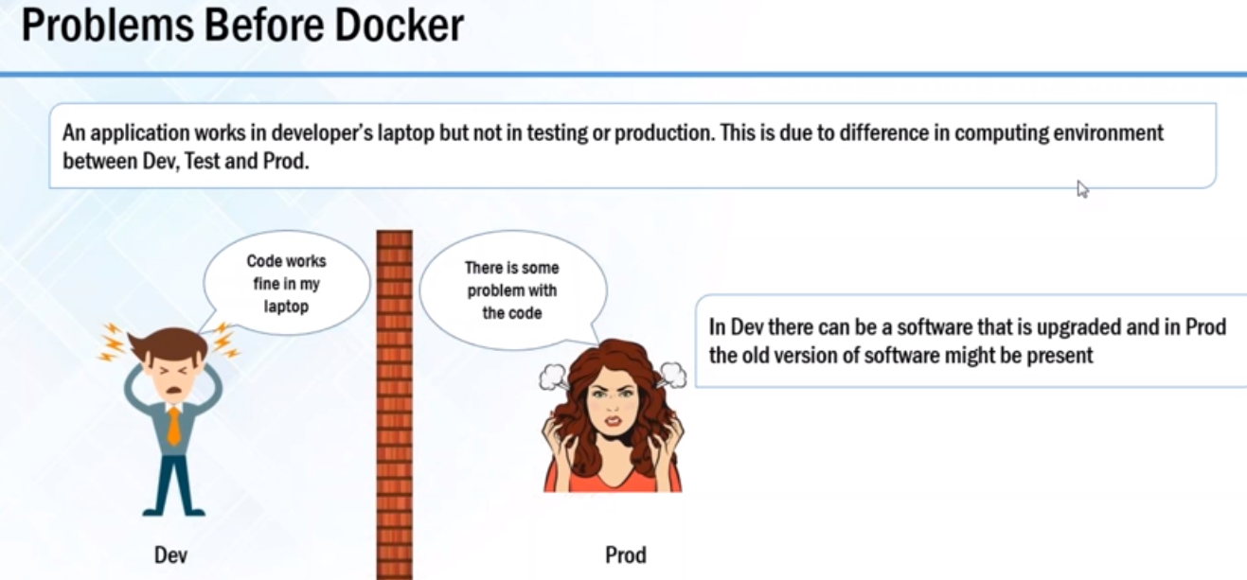
Docker

Slide 3
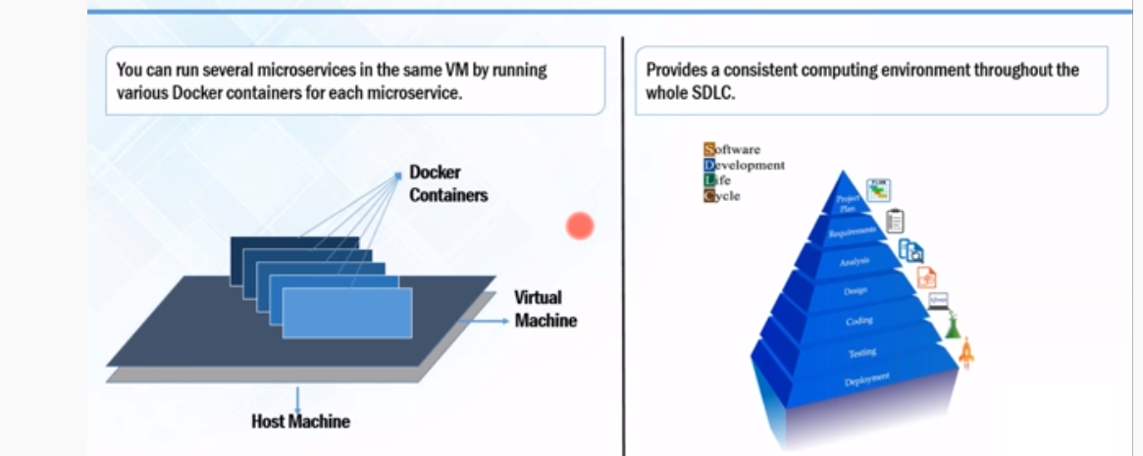
Docker

Slide 4
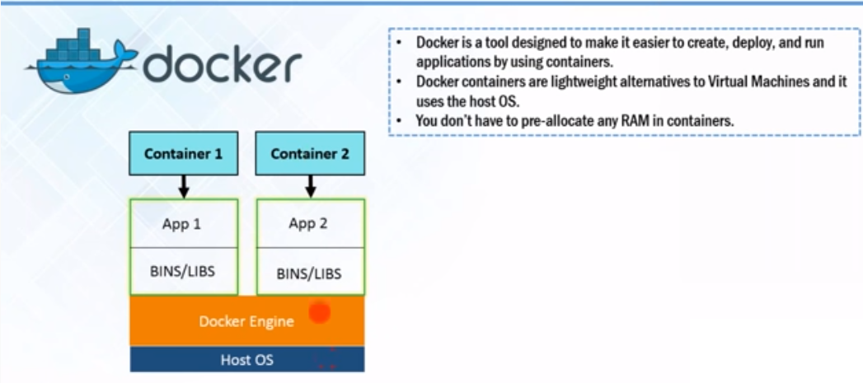
Docker

Slide 5
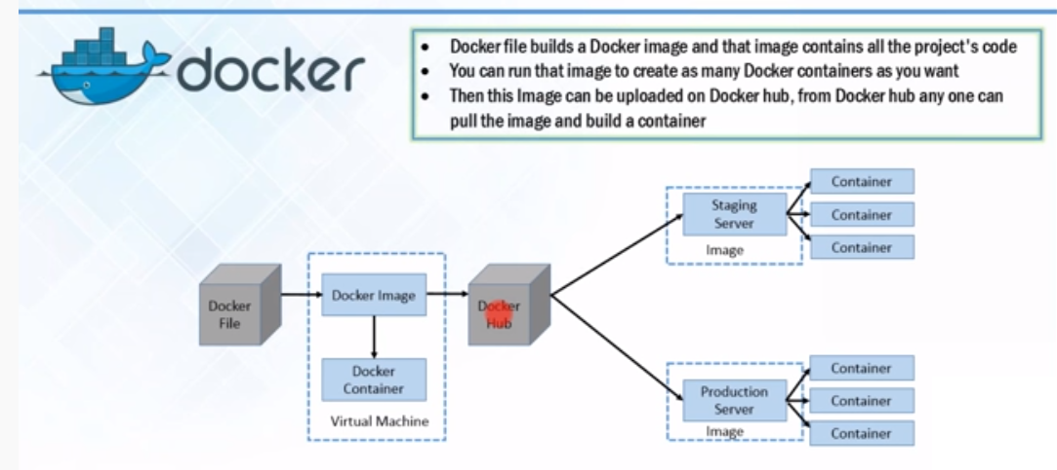
Docker

Slide 6
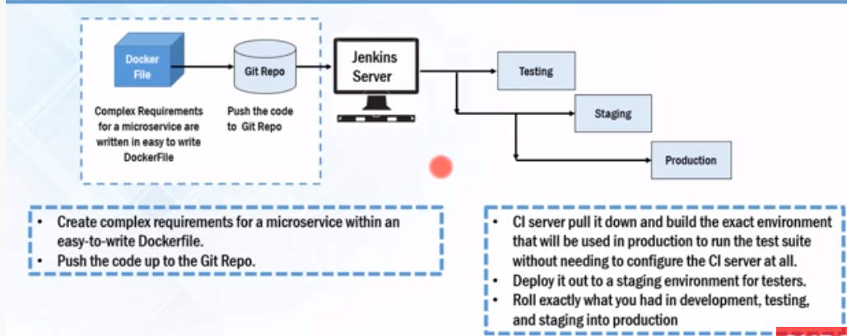
Docker

Slide 7
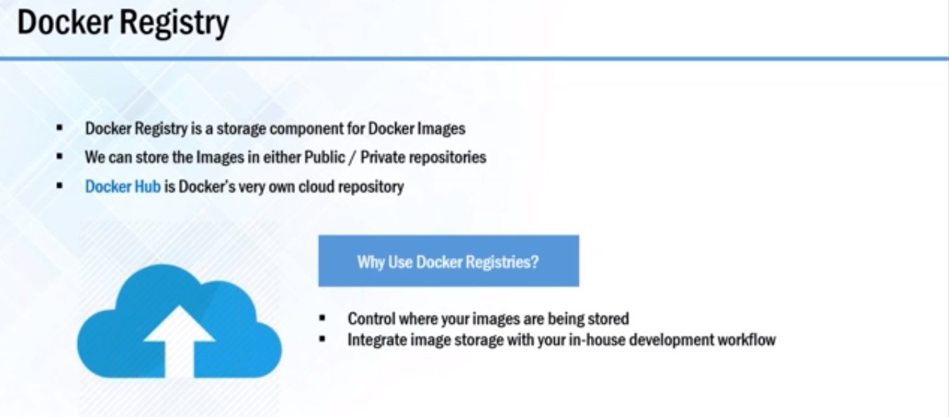
Docker

Slide 8
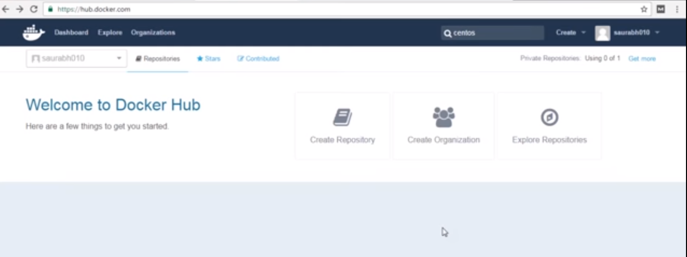
Docker

Slide 9
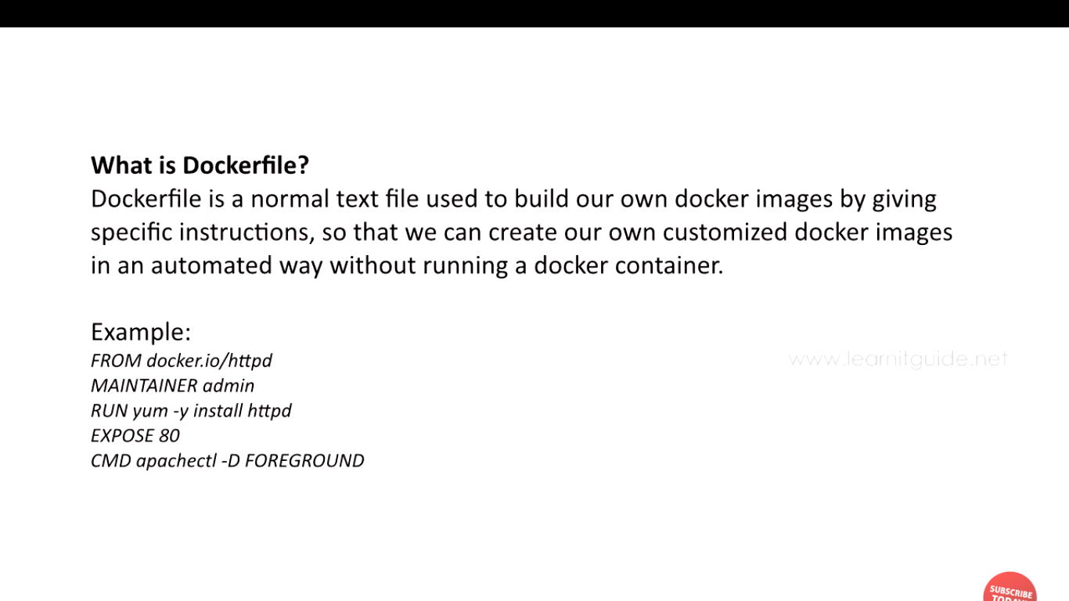
Docker

Slide 10
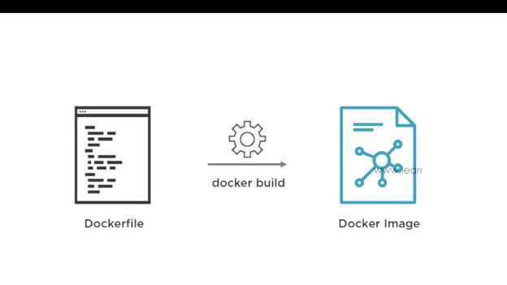
Docker

Slide 11
Docker
DOCKER INSTALLATION DEMO

Slide 12
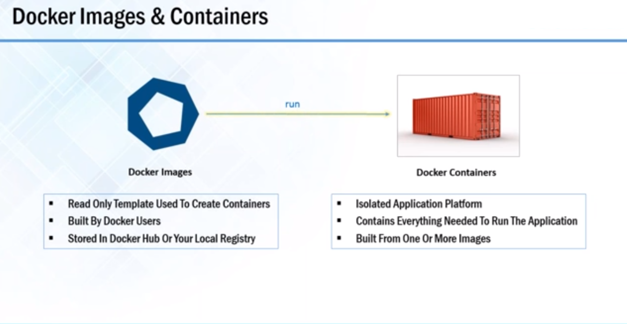
Docker

Slide 13
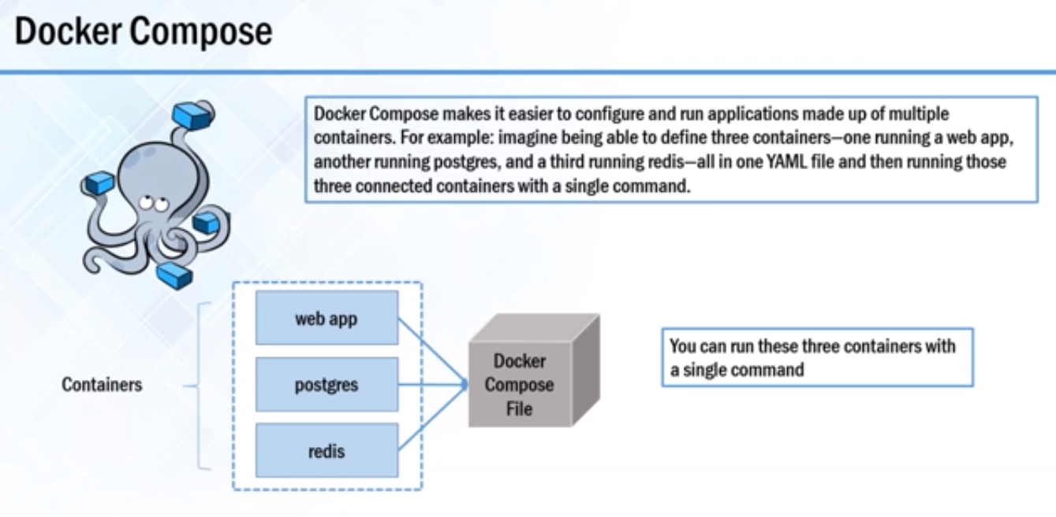
Docker

Slide 14
Docker
Container are method of operating system virtualization that allow you to run application and its dependencies in resource isolated process.
Container allows you to easily package an application code, configurations and dependencies into easy to use building blocks and that application can be deployed quickly and consistently regardless of deployment environment

Slide 15
Docker
Linux kernel features that create the walls between container and other processes running on the host.
To understand Containers We have to start with Linux Cgroup and Namespace & Union File System.
Linux Namespace - Wrap a set of system resources and present them to a process to make it look like they are dedicated to that process.

Slide 16
Docker
Linux Cgroup - Governs the isolation and usage of system resources such as cpu and memory for group of process.E.g. - If you have a application that takes up lot of cpu cycles and memory such as scientific computing application you can put the application in a cgroup to limit a CPU and memory usage.

Slide 17
Docker
Namespaces deal with resource isolation for single process
Cgroup manages resources for group of processes

Slide 18
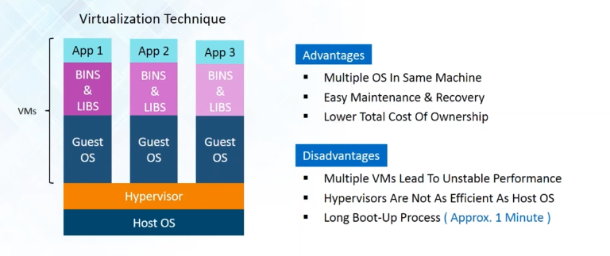
Virtualization

Slide 19
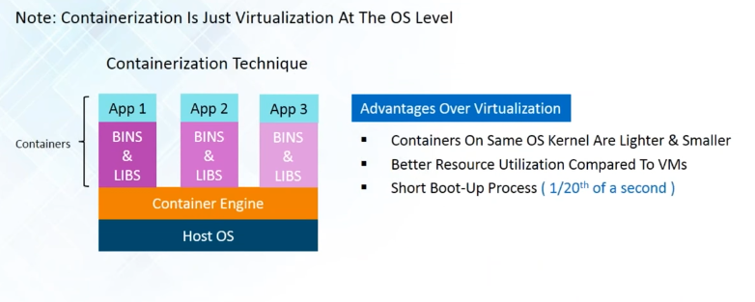
Containerization

Slide 20
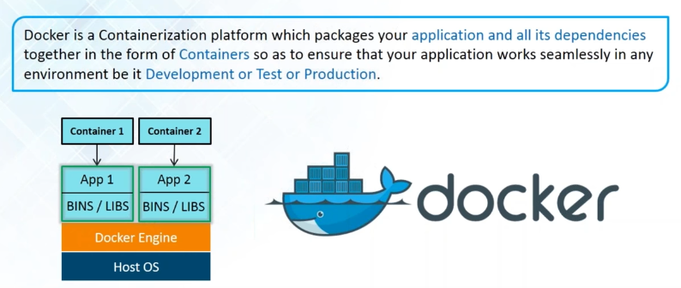
Docker Info

Slide 21
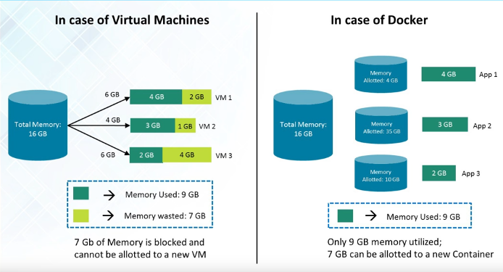
Docker Info

Slide 22
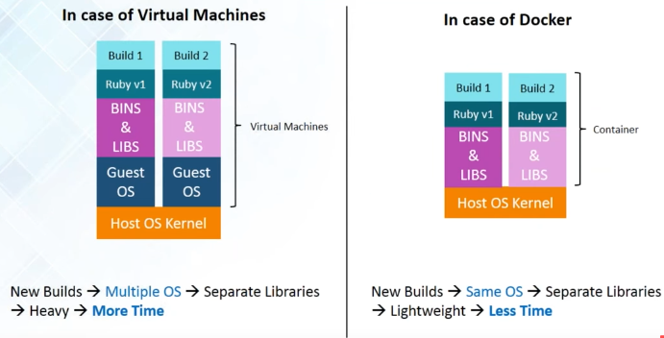
Docker Info

Slide 23
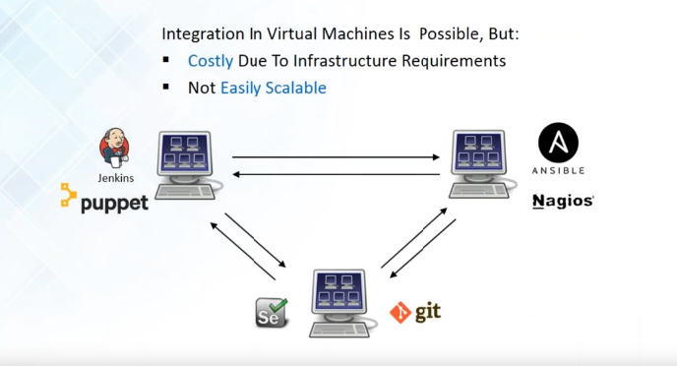
Integration in VMs

Slide 24
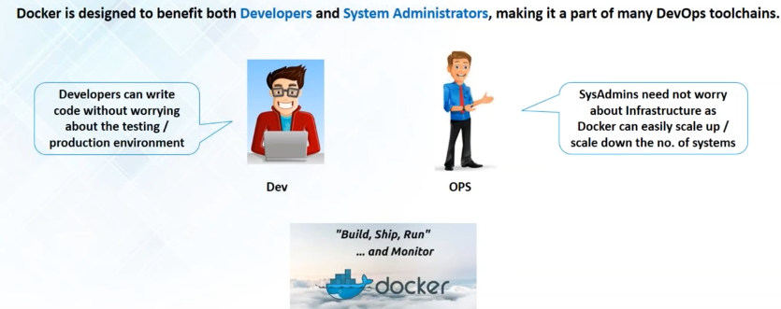
Who Can Use Docker

Slide 25
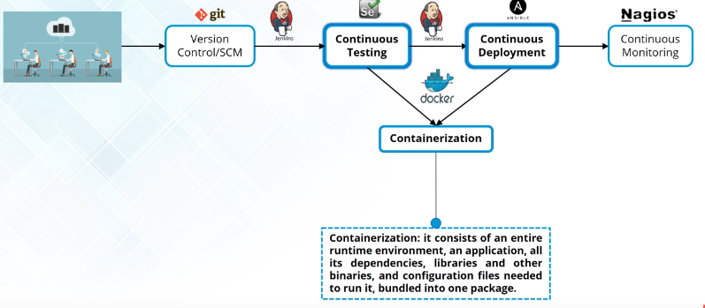
How is Docker Used In Devops

Slide 26
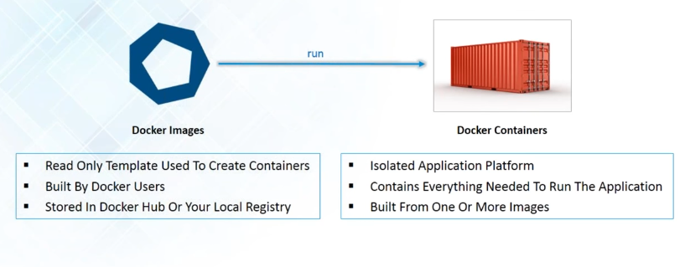
Docker Images & Containers

Slide 27
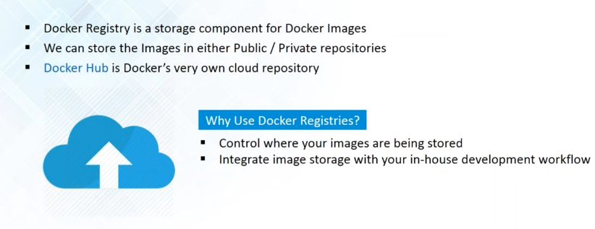
Docker Registry

Slide 28
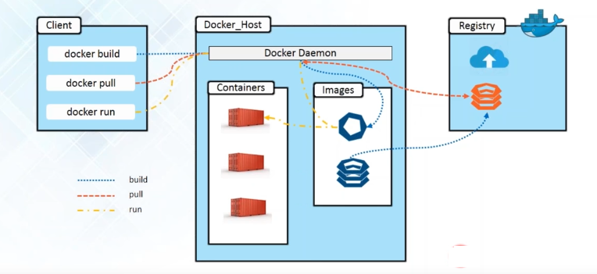
Docker Architecture

Slide 29
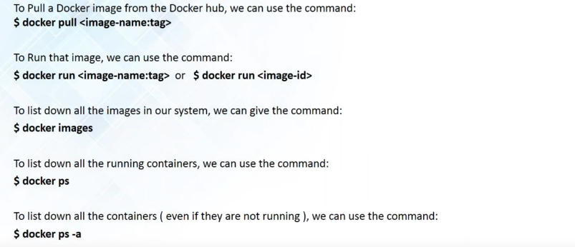
Basic Docker Commands

Slide 30
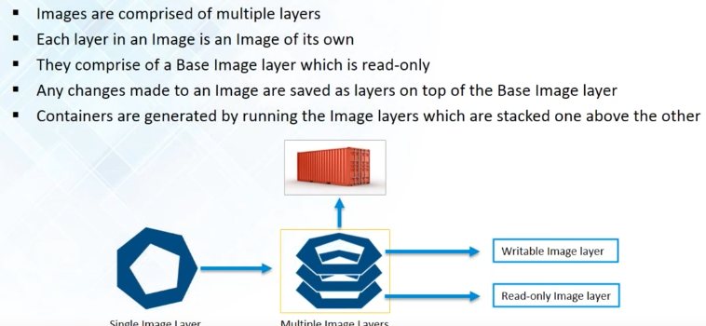
Building Images

Slide 31
Docker File Instructions https://docs.docker.com/engine/reference/builder/#environment-replacement
Instruction | Comments
FROM <image>:<tag> | Tells Docker what will be the base for the image being created
ADD | Copies the files from the source on the host into the Docker image's own filesystem at the desired destination. Command is not only about copying files from the local filesystem--you can use it to get the file from the network.
COPY | It will copy new files or directories from <source path> and adds them to the filesystem of the container at the path <destination path>.
CMD / ENTRYPOINT | CMD ["executable","parameter1","parameter2"] his is the so-called exec form CMD command parameter1 parameter2 This a shell form of the instruction
RUN | Instruction will execute any commands in a new layer on top of the current image and then commit the results
EXPOSE | Instruction informs Docker that the container listens on the specified network ports at runtime.

Slide 32
Docker Compose

Slide 33
Multi-container apps are a hassle
Build images from Dockerfiles
Pull images from the Hub or a private registry Configure and create containers
Start and stop containers

Slide 34
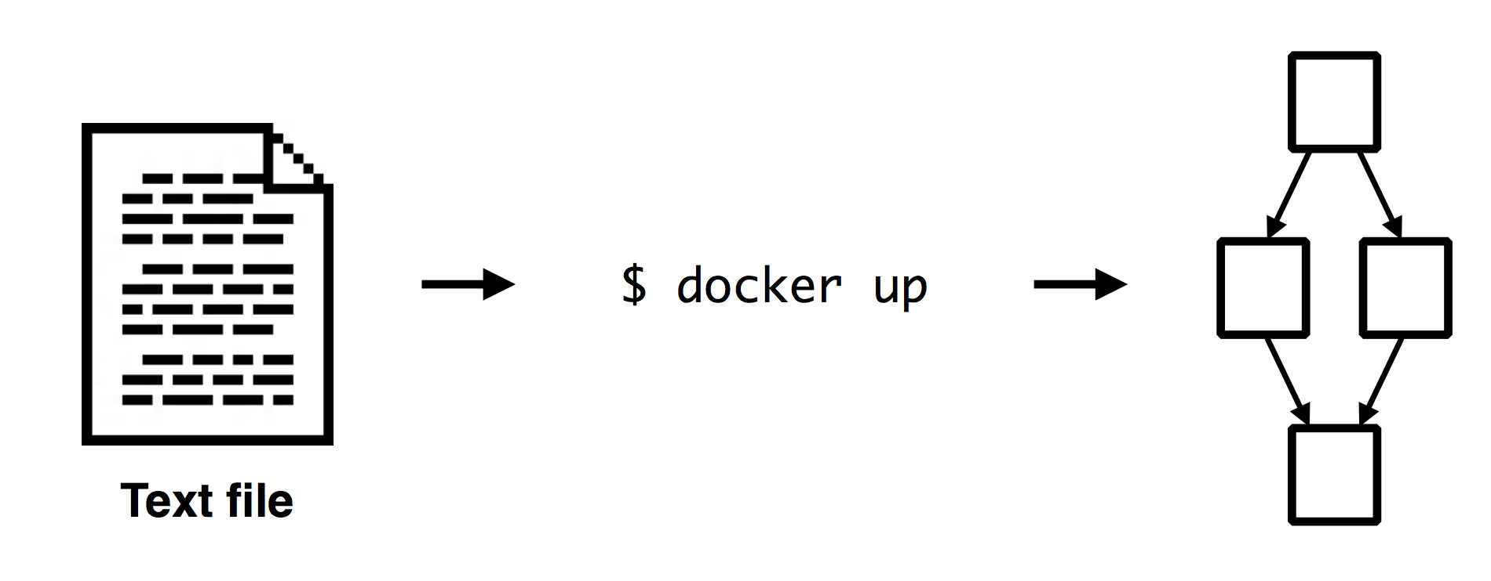
Docker Compose

Slide 35
Overview
Compose is a tool for defining and running multi-container Docker applications. With Compose, you use a Compose file to configure your application’s services. Then, using a single command, you create and start all the services from your configuration.

Slide 36
Dockerfile
FROM python:2.7
MAINTAINER Peng Xiao "xiaoquwl@gmail.com"
COPY . /app
WORKDIR /app
RUN pip install -r requirements.txt
EXPOSE 5000
CMD [ "python", "app.py" ]

Slide 37
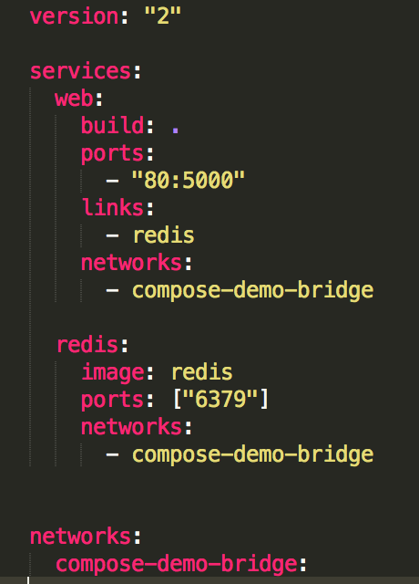
docker-compose.yml
web
redis
compose-demo-bridge

Slide 38
Docker Swarm

Slide 39
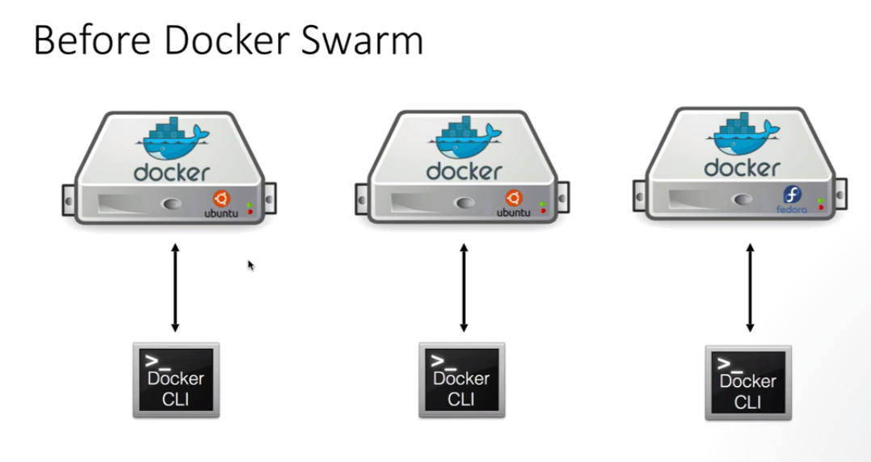

Slide 40
